Slide 1

2025-11-16
Bright TV: Channel Analytics

Slide 2
Executive Summary
Expanded key takeaways:
Light viewers dominate (97%) but contribute less per person
Heavy viewers are rare (<1%) yet drive disproportionate minutes watched
Moderate viewers (3%) represent a growth opportunity
Evenings are peak viewing hours
Heavy viewers cluster around a few channels
Younger age groups and certain provinces show higher engagement
Retention challenge: most users watch only once
Strategic opportunity: convert Light → Moderate viewers and retain repeat users

Slide 3

Market Concentration Risk Mitigation
Current market shows dangerous dependency with HHI of 2,387 and top 5 channels controlling 79.7% of viewing time. Sports content dominates at 54.4% share, creating vulnerability to external content providers. Recommend expanding non-sports portfolio to 35-40% industry benchmark and negotiating multi-year licensing agreements to protect against content loss, particularly given cricket's 27.6% market dominance.
HHI Index
Top 5 Control
Sports Share
2,387
79.7%
54.4%
High market concentration indicating risk
Dominant channels control viewing time
Current sports content dependency level

Slide 4
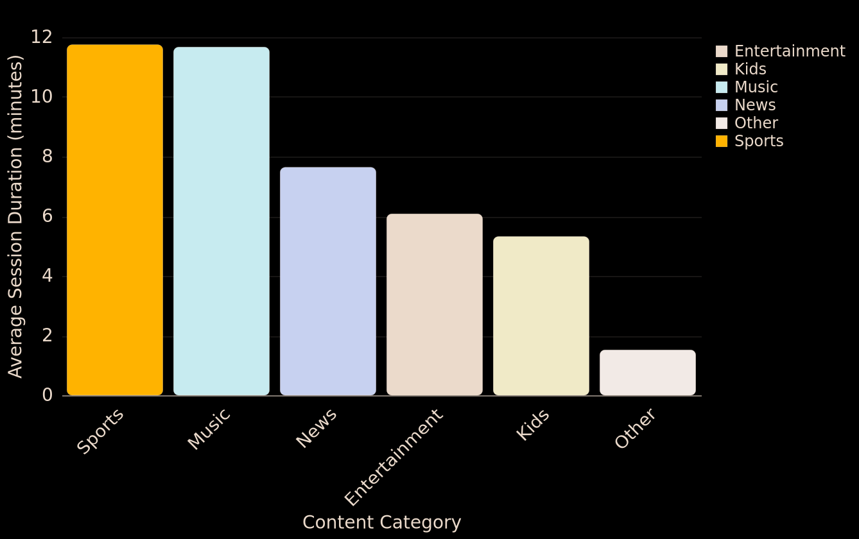
Sports vs Entertainment Performance Gap
Key Metrics
Sports content significantly outperforms industry averages with 11.75-minute average sessions vs 11-18 minute global benchmarks, while entertainment channels underperform at 6.08 minutes. Sports viewers show 2.5x longer engagement than kids content, aligning with industry patterns of extended live sports viewing.
Sports Duration
11.75 min
Outperforms industry benchmarks significantly
Content Category Performance Benchmarking: Average Session Duration
Entertainment
6.08 min
Underperforms compared to other categories
Engagement Rate
10.86%
Long-form content engagement performance

Slide 5
Sports vs Entertainment Engagement
Significant performance gaps exist between content categories. Sports content achieves 11.75-minute engagement with 16.44-minute average sessions, while entertainment severely underperforms at 6.08-minute sessions. The 84.68% male audience dominance indicates need for diversification. Recommend applying sports success model to entertainment through longer-form series and live programming while developing targeted content for broader demographics.
Sports Avg
Entertainment
16.44 min
6.08 min
Strong performance benchmark to replicate
Below industry standard, needs improvement

Slide 6
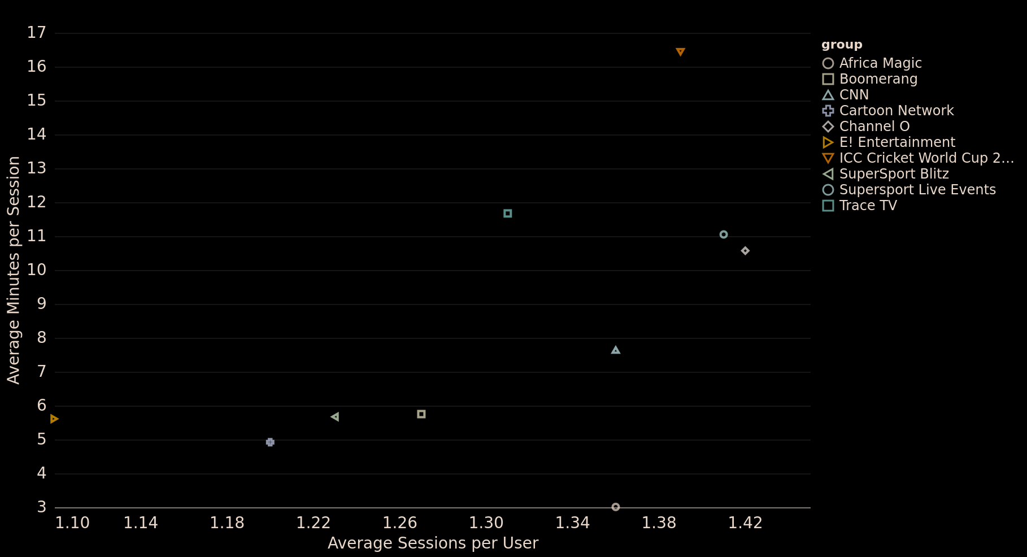
Engagement Strategy Insights
Key Metrics
Channel portfolio exhibits strong user loyalty with top channels achieving 1.36-1.42 average sessions per user. Sports content attracts balanced user segments (45% light, 51% moderate, 4% heavy), while entertainment skews heavily toward light users (62-97%), indicating differentiated engagement strategies needed.
Channel Loyalty
1.42 avg
Channel User Engagement vs Loyalty Patterns
Average sessions per user across top channels
Light Users
95%
Dominant user segment distribution pattern
Multi-Channel
42.13%
Users engaging with multiple channels

Slide 7
Middle Funnel Expansion
Implement a graduated engagement strategy to expand the middle funnel and reduce dependency on the tiny Heavy user base. Focus on converting the massive Light user population (97.47%) to Moderate status through personalized onboarding, content recommendation improvements, and engagement triggers.
Light Users
Engagement Gap
Session Length
97.47%
40.65x
7.36 min
Massive population requiring conversion strategy
Extreme gap indicating broken user progression
Current average vs 15-20 min industry benchmark

Slide 8
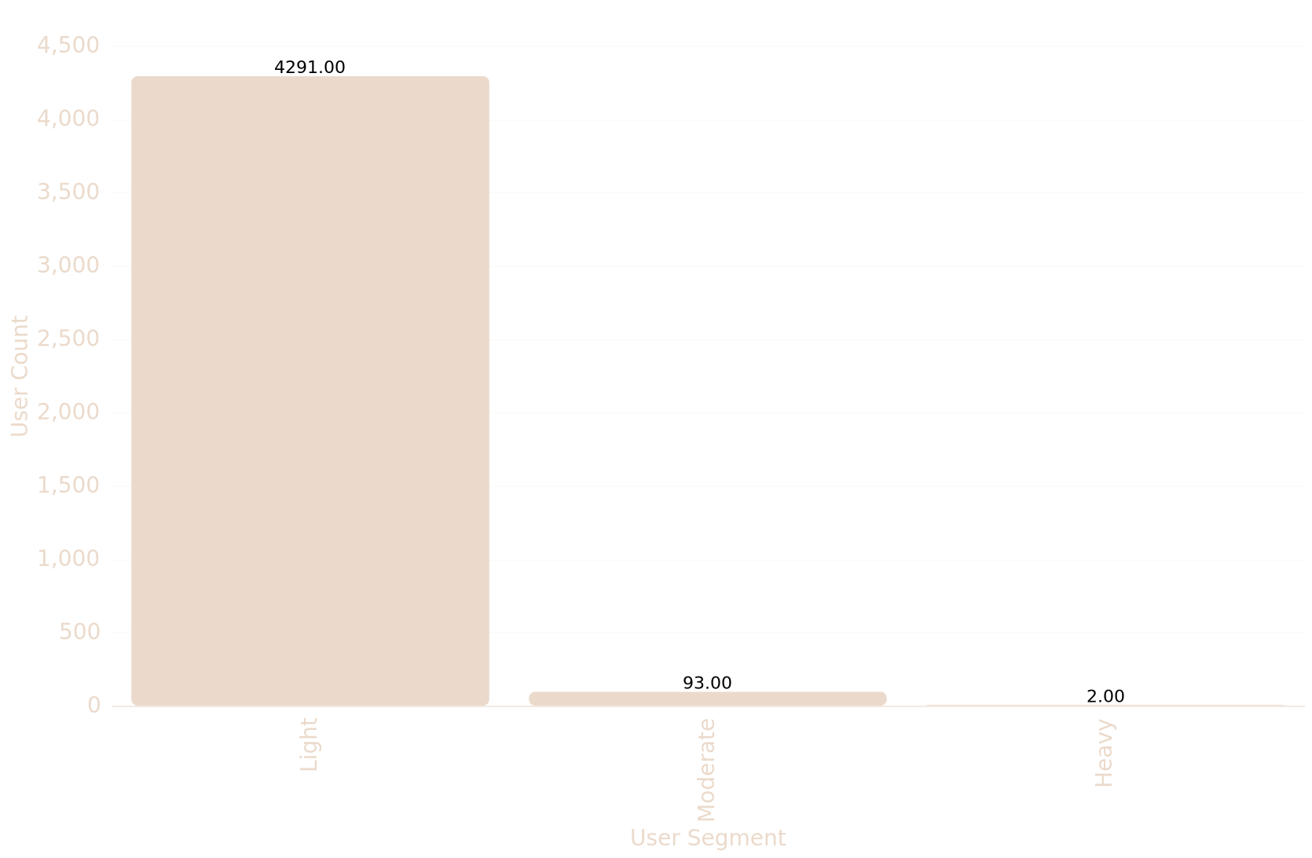
Distribution Pattern Analysis
Key Metrics
Analysis reveals a highly skewed user engagement distribution with 93.76% Light users, 6.17% Moderate users, and only 0.07% Heavy users. This pattern indicates significant engagement gaps between segments, with top users demonstrating 40.65x higher engagement multiplier compared to light users, creating substantial value concentration opportunities.
Light Users
97.47%
Dominant user segment with minimal engagement
User Engagement Funnel Distribution by Segment
Gap Multiplier
40.65x
Engagement difference between user segments
Session Time
7.36 Min
Average session duration across all users

Slide 9
Channel Portfolio Distribution
Analysis of channel portfolio distribution reveals significant market concentration with top 5 channels capturing 79.67% of total viewing time. Sports channels dominate with ICC Cricket Cup commanding 27.6% market share and 16.44-minute average sessions, while total sports viewing represents 54.4% of platform engagement.
Market Conc.
Sports Share
Top 5 Share
HHI: 2,387
54.4%
79.7%
High market concentration index indicates dominance
Sports content drives majority of engagement
Leading channels capture most viewing time

Slide 10
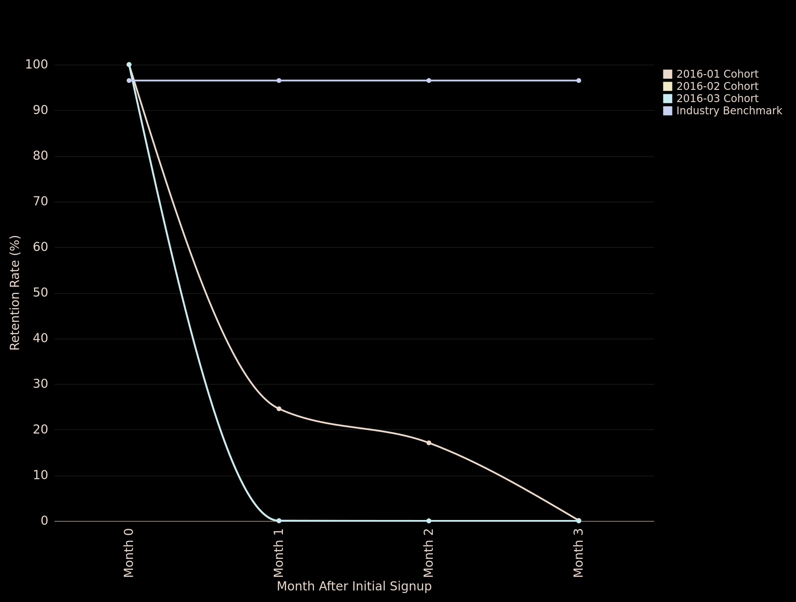
Temporal User Retention Insights
Monthly Cohort Retention Rates vs Industry Benchmark
Temporal analysis of user retention across cohorts and segment transitions. Industry benchmarks suggest healthy OTT retention rates of 70-80%, but data shows January 2016 cohort retention dropped to 0.09% by April, indicating critical retention issues. Day 0 churn rate reaches 83.56% with Month 1 retention at only 17.81%, leading to significant revenue impact of $176,640.

Slide 11
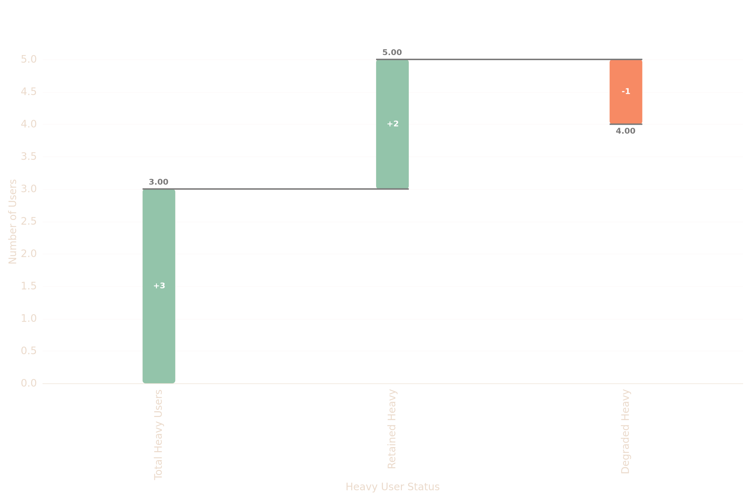
Heavy User Degradation Pattern
Heavy User Engagement Degradation Flow
Analysis reveals that 50% of Heavy users transition to Moderate/Light engagement segments within an average of 8 days. This rapid degradation represents a critical loss of high-value users, with only 3 users (0.07%) maintaining Heavy status. The retention performance of 66.67% falls below industry benchmarks of 70-80%, indicating urgent need for intervention strategies to prevent further user engagement decline.

Slide 12
12:00-17:00 Afternoon Window Strategy
Optimize content scheduling and advertising placement during the 12:00-17:00 afternoon window which captures 44.57% of total viewing time, particularly targeting 17:00 (5PM) as the peak viewing hour with 8.43% share. Shift premium content and advertising investment from traditional 8PM-11PM slots to this 3-4 hour earlier primetime window to align with South African viewing behaviors.
Afternoon Share
Peak Hour
Top 5 Hours
44.57%
8.43%
38.24%
Total viewing time during 12:00-17:00 window
17:00 (5PM) represents highest viewing share
Concentrated viewing share in afternoon peak

Slide 13
Weekday-Optimized Content Strategy
Implement weekday-optimized content strategy targeting the dominant 67.70% weekday audience by scheduling premium releases and live events during Tuesday-Friday peak periods (13.07%-16.53% daily share). Leverage the Saturday peak at 19.57% for special weekend programming while recognizing that South African viewers maintain shorter session durations compared to global patterns.
Weekday Share
Weekend Peak
67.70%
19.57%
Dominant weekday audience concentration
Saturday represents highest weekend viewing

Slide 14
Live Sports Engagement Premium
Prioritize live sports and event programming as premium inventory windows to maximize viewer engagement and advertising revenue potential. Live events demonstrate 71.41% higher average session duration and generate 144% more extended viewing sessions (>60 minutes) compared to regular content. Focus scheduling and promotional resources on afternoon time slots where live sports achieve peak engagement.
Duration Boost
Extended Views
Peak Sessions
71.41%
144%
14.09 min
Higher average session duration for live events
More sessions over 60 minutes vs regular content
Average session duration during afternoon slots

Slide 15
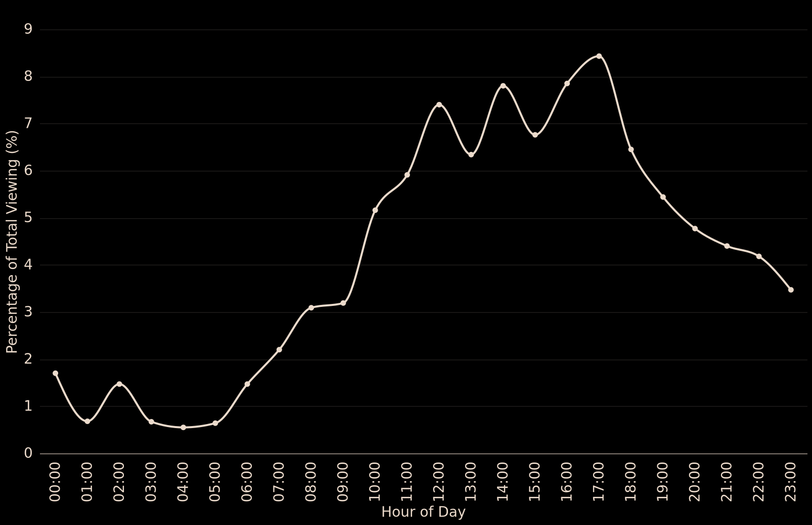
Afternoon-Evening Dominance Pattern
Key Metrics
Analysis of peak viewing hours reveals afternoon-evening dominance with 17:00 showing highest engagement (8.43% of total). Compared to industry standards showing 8-10pm primetime, South African viewers peak 3-4 hours earlier, aligning with local time zones and work schedules.
Peak Hour
17:00
Highest engagement at 17:00 with 8.43% share
Prime Time Viewing Concentration by Hour
Afternoon Share
44.57%
Afternoon dominance in viewing patterns
Top 5 Hours
38.24%
Combined share of top 5 viewing hours

Slide 16
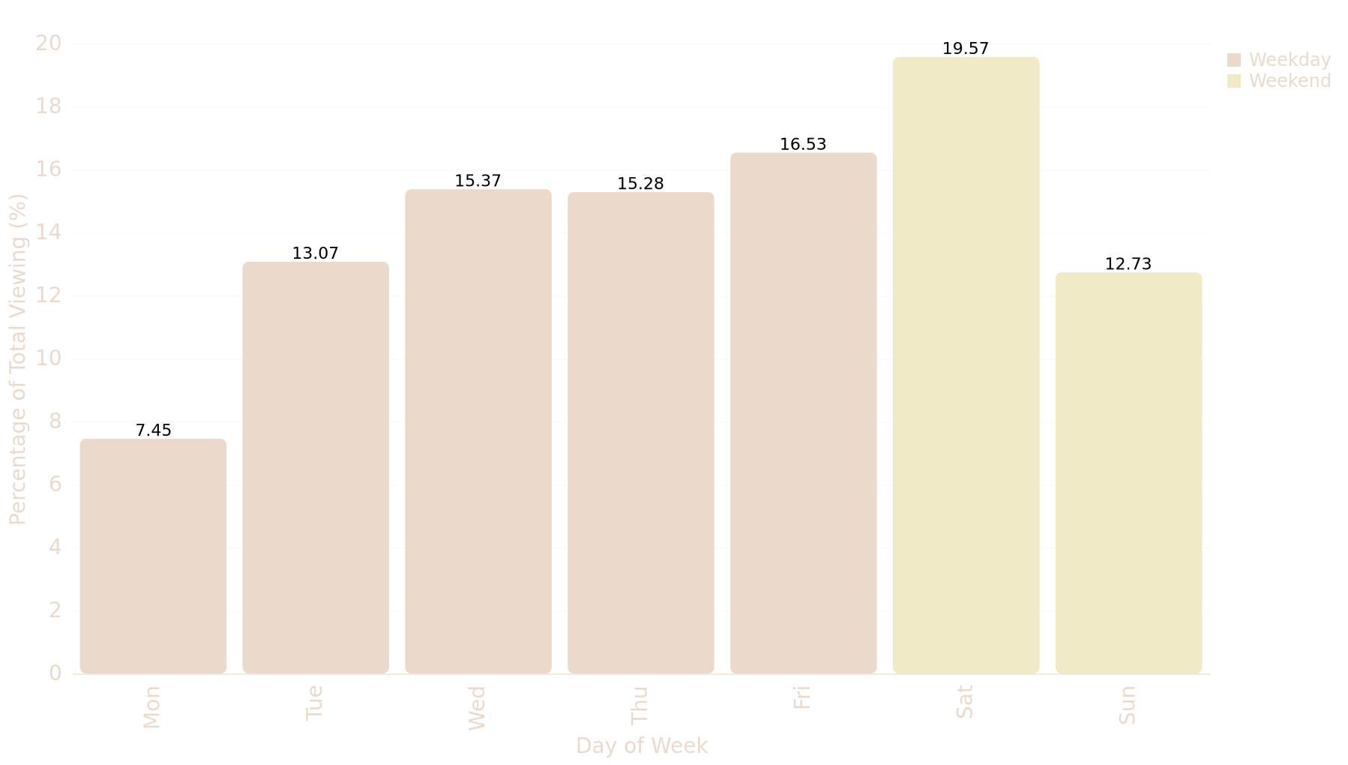
Weekend vs Weekday Consumption Patterns
Key Metrics
Weekend viewing accounts for 32.30% of total consumption versus 67.70% on weekdays, with Saturday leading at 19.57%. This contrasts global streaming patterns where weekends typically dominate, indicating work-from-home or flexible viewing habits among DStv subscribers.
Weekend Share
32.30%
Total weekend viewing as percentage of consumption
Daily Viewing Distribution - Weekend vs Weekday Patterns
Saturday Peak
19.57%
Highest single day viewing concentration
Duration Gap
0.73 min
Session duration difference between periods

Slide 17
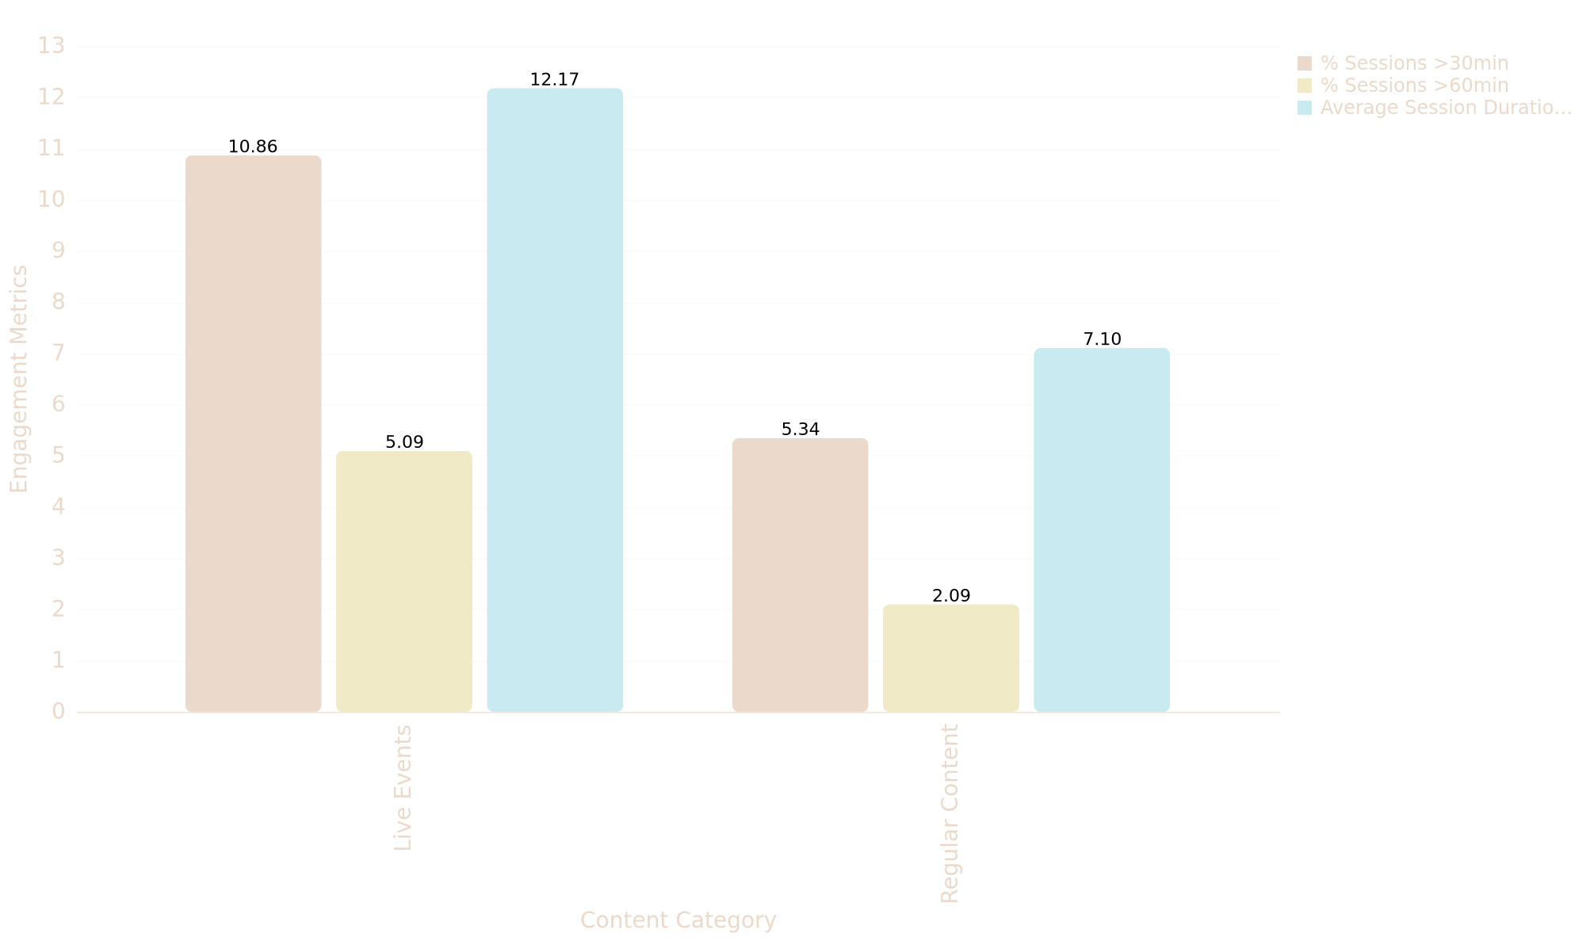
Event Impact on Viewing Behavior
Key Metrics
ICC Cricket World Cup 2011 demonstrates clear event impact with 16.44 minutes per session intensity and 158 high-engagement sessions (>44 min), while Supersport Live Events shows 11.05 min/session, indicating live sports drive significantly longer viewing durations compared to regular content.
Live Premium
71.41%
Engagement premium for live events over regular content
Event-Driven Viewing Engagement: Live Events vs Regular Content
High Sessions
5.09%
Rate of high-intensity viewing sessions (>44 min)
Cricket Peak
16.88 min
Average session duration during Cricket World Cup

Slide 18
Millennial Market Dominance Strategy
Leverage the 43.89% millennial dominance while addressing demographic imbalances through strategic content diversification. Prioritize millennial-focused premium content and advertising partnerships given their 68.81% combined market power with 35-44 group, but simultaneously invest in Gen Z engagement strategies to capture the underperforming 20.39% youth segment through social media integration, mobile-first experiences, and trending content formats.
Millennial Share
Combined Power
Gen Z Segment
43.89%
68.81%
20.39%
Dominant demographic driving platform engagement
Millennial + 35-44 age group market influence
Underperforming youth demographic opportunity

Slide 19
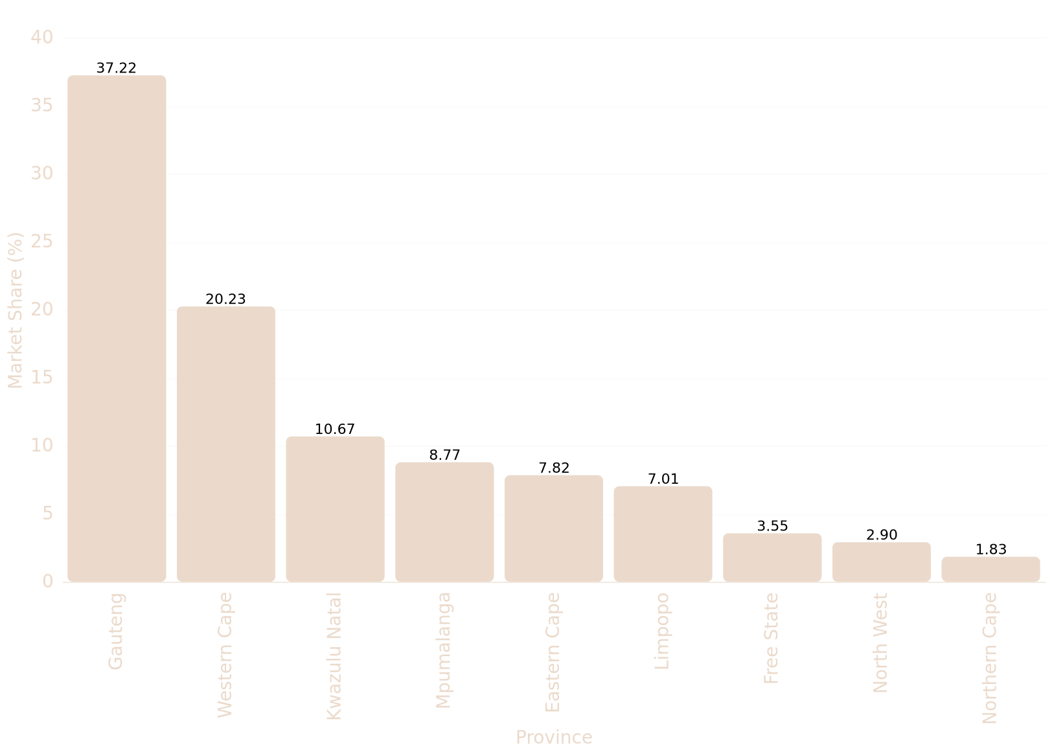
Provincial Consumption Patterns
Market Metrics
Gauteng and Western Cape provinces demonstrate market leadership accounting for 56.6% of total consumption (49,909 minutes combined), aligning with South African OTT research showing these economic centers capturing 63.7% of streaming audiences, validating their strategic importance in the digital content landscape.
Hub Dominance
57.45%
Economic hub provinces control majority share
Provincial Market Share in Content Consumption
Concentration
2120 HHI
High market concentration index indicates focus
Density Gap
3.8x Diff
Significant consumption variance between regions

Slide 20
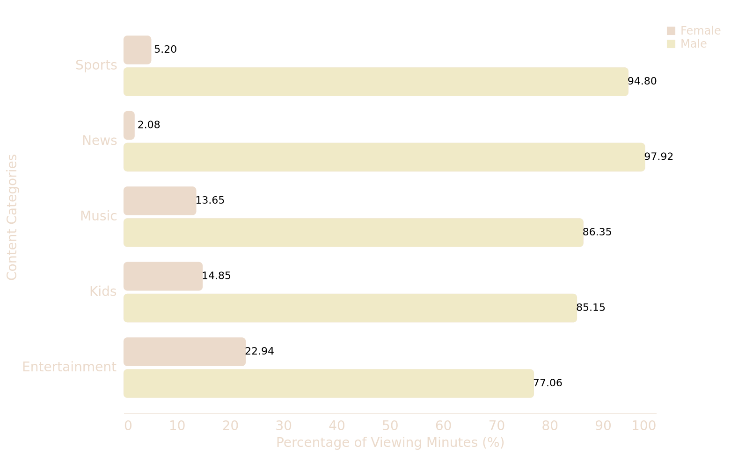
Gender Distribution Analysis
Key Metrics
Male viewers represent 87.61% of sessions and 88.54% of viewing minutes, contrasting with global streaming trends showing 55-60% male dominance and South African studies indicating 65.5% male OTT consumption, suggesting sport-heavy content strategy resonates with male demographics.
Sports Content
56.52%
Male dominance vs 30.24% female in sports viewing
Gender Distribution by Content Category (Viewing Minutes %)
Cricket Share
28.69%
Male cricket consumption vs 12.63% female
Session Length
11.82 min
Male average vs 10.83 minutes female

Slide 21
Content Portfolio Diversification Strategy
The extreme male dominance (94.8% sports viewership) indicates missed revenue opportunities from underserved female demographics. Implement a phased content diversification strategy by adding lifestyle programming, reality shows, and behind-the-scenes sports content that appeals to women. Start with 25% budget allocation toward female-oriented programming to gradually shift the current 87.61% male session dominance toward a more balanced 70-30 split.
Male Dominance
Session Share
Growth Target
94.8%
87.61%
30-40%
Current sports viewership gender split
Male-dominated platform engagement
Potential engagement increase from female participation

Slide 22
Primary Growth Markets Strategy
Prioritize Gauteng and Western Cape as primary growth markets due to their 57.45% consumption dominance and superior infrastructure capabilities. Implement targeted premium content strategies for the 25-34 age demographic which drives 70.3% of economic hub consumption. Simultaneously, develop rural market penetration strategies focusing on mobile-first experiences and affordable data packages to capture the underserved 42.55% of remaining provincial markets.
Hub Dominance
Rural Gap
57.45%
3.8x
Gauteng + Western Cape consumption share
Consumption density difference vs leading provinces

Slide 23
2025-11-16
Thank you

